Slide 1
Using Social Media for Outreach, Marketing and Building Community
Karla Frizler • Subject Matter Expert, OTAN Riverside About Students Consortium Annual PD Conference November 16, 2018
Notes:
22 years in higher education
background in ESL and instructional design
adult ed and community college

Slide 2
Agenda/Objectives
Part I (Session 10, 9:40-10:30, Imperial):
Learn about the purpose & value of popular social media tools
See examples of social media use in Adult Education
Part II (Session 20, 10:40-11:30, Imperial):
Evaluate effective use of social media in Adult Education
Begin developing a social media marketing plan
Discuss caveats/things to consider
Discover additional resources available
Notes:
If you’re already tech savvy about social media, come back for Part II

Slide 3
PART I: Overview/Tools/USES

Slide 4
ACTIVITY!
Photo by rawpixel on Unsplash
Notes:
Take group photo
Collaboratively write post to promote Part II of workshop: - What should post say? - Which hashtags should we include? (#RIVERSIDEAEP2018, #AdultEDU)
Use Hootsuite to post to Facebook, Twitter and LinkedIn (IG?)
Promote: Part II (Session 20, 10:40-11:30, Imperial):
Evaluate effective use of social media in Adult Education
Begin developing a social media marketing plan

Slide 5
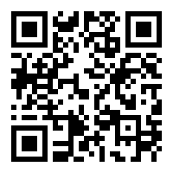
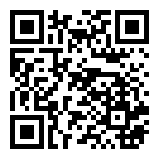
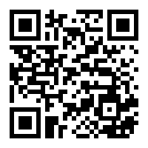
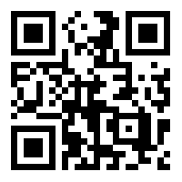
Let’s Connect!
Karla L. Frizler
kfrizler
Karla L. Frizler
kfrizler
Notes:
Handout: See back of cover page – add me on at least one app to follow along or participate!

Slide 6
Why use social media marketing?
“What makes social media so valuable and revolutionary ... is the two-way communication stream—the conversation— that is intrinsic to the technology.” ~ Daniel Oase
http://a.co/d/eV5WiJR
Notes:
How have we traditionally marketed our classes, programs and agencies?
Brochures/mailers to homes
Marquee at agency site
Banners, flyers at public events

Slide 7
Social Media Tools
Photo by Rahul Chakraborty on Unsplash

Slide 8
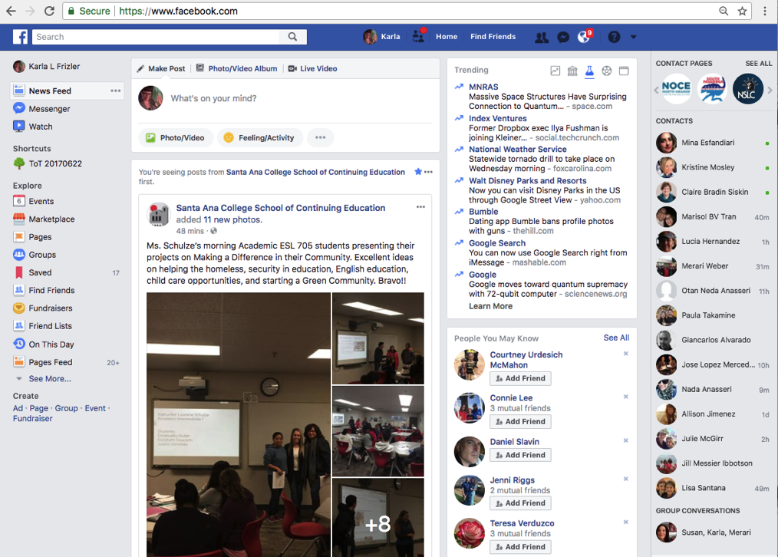
Facebook (“FB”)
Notes:
Social networking – personal and professional
Individual pages
Business pages
Groups – public, closed, secret
Events
Polls
Unlimited discussion threads
Photos
Videos
Other apps can post in FB
Paid “boosts”

Slide 9
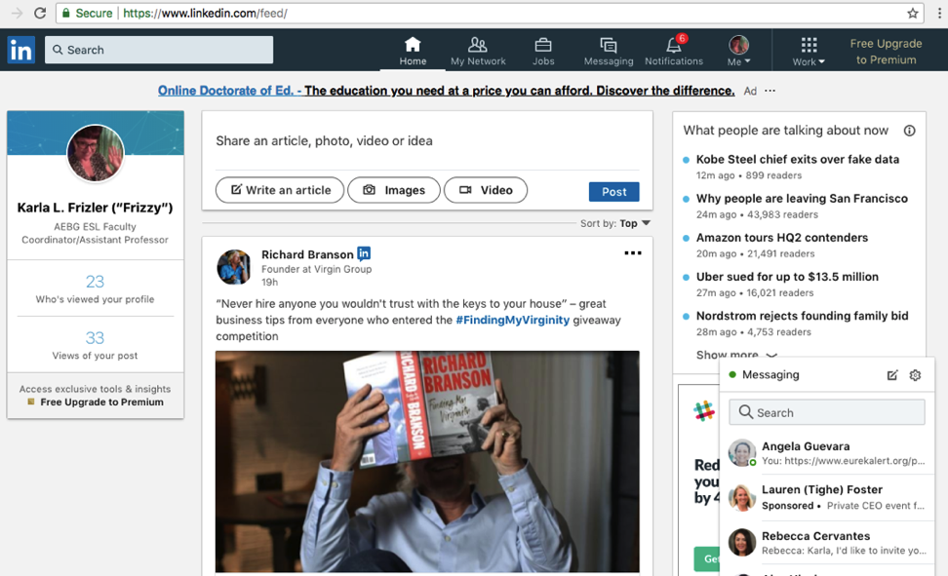
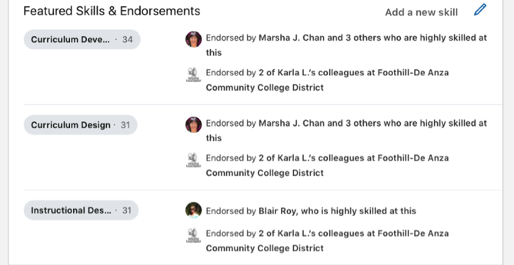
LinkedIn
Notes:
Social networking – professional
Individual profiles
Business profiles
Job posting/search
Endorsements
Interests
Direct publishing (articles to establish yourself as an expert in the field)

Slide 10
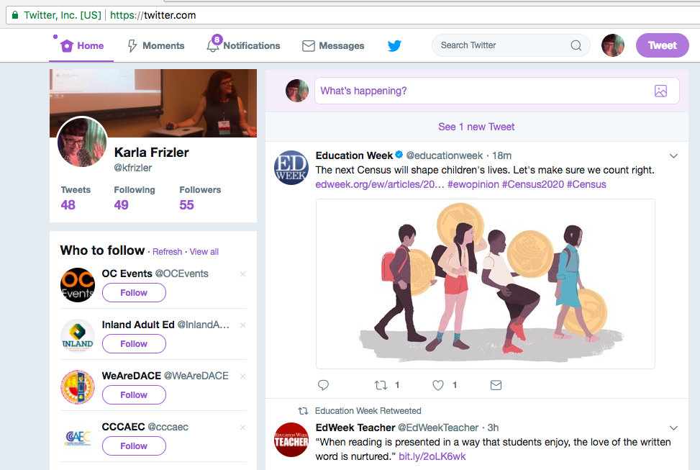
Twitter
Notes:
Blog (“microblogging”) – character limit (increased to 280 in 2017, from 140)
Live video
Retweet (quote retweet)
Twitter lists (target marketing)
Pinning

Slide 11
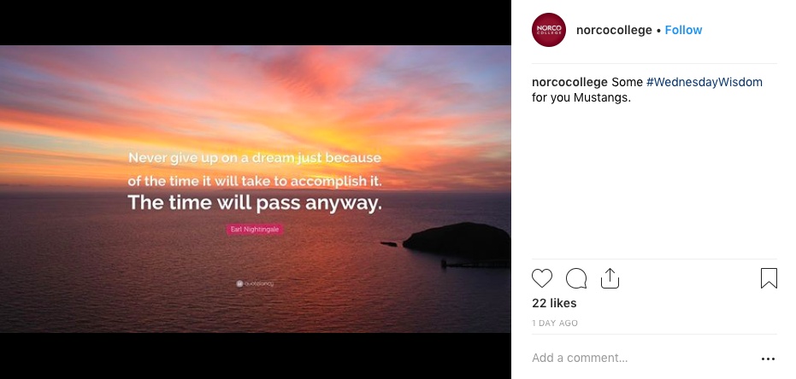
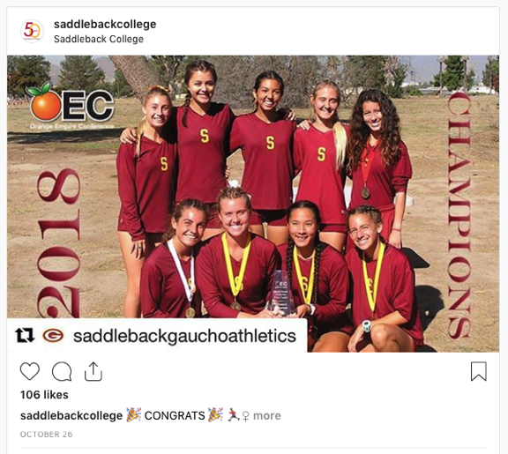
Instagram (“IG)
Notes:
Content community (video/photo sharing)
Hashtags
Boomerang
Polls
Short comments

Slide 12
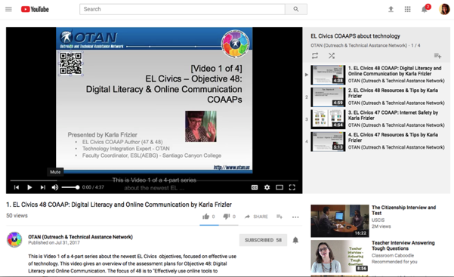
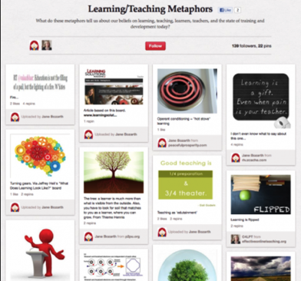
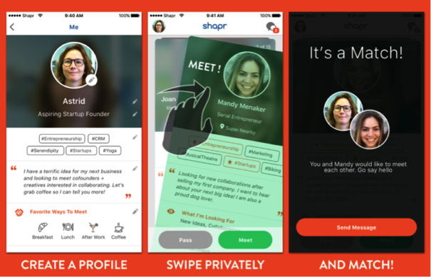
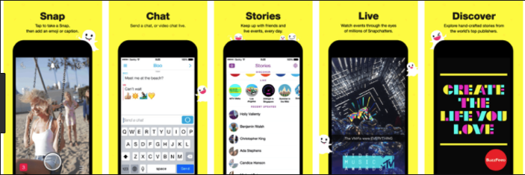
YouTube/Snapchat/Pinterest/Shapr*
Notes:
YouTube: Content community (video sharing)
Snapchat:
Content community (video sharing)
Skins (location, event)
Not good for reference, returning later
Can take/download screenshots, so posts don’t completely “disappear”
Pinterest:
Content community (photo sharing)
Boards grouped thematically
Shapr:
Social networking – professional
Based on online dating model
Swipe right to show interest; swipe left to pass
Professional networking goals

Slide 13
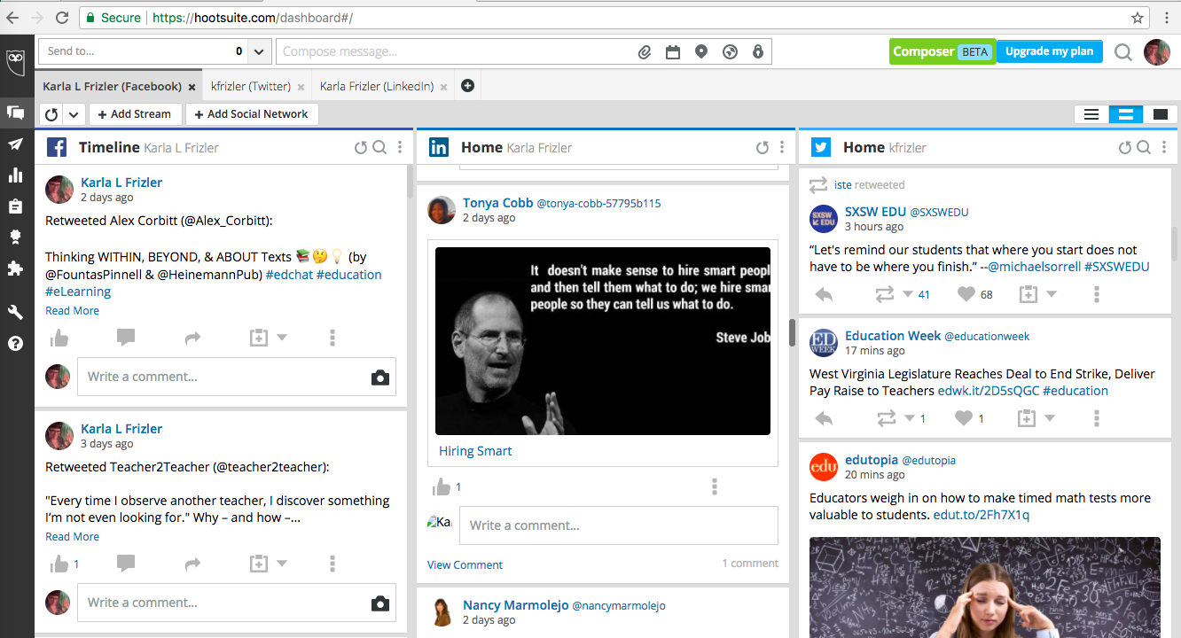
Hootsuite
Notes:
Brings all social media together to streamline posting
Free subscription: 3 social media outlets with one post
Paid subscription: 10+ social media outlets with one post (https://hootsuite.com/plans for pricing, $29/mo+)

Slide 14
ACTIVITY!
Take 5 minutes to share with a neighbor how you, your department/program, and your agency use social media tools
Photo by Saulo Mohana on Unsplash
Notes:
Check Facebook, LinkedIn, Twitter for earlier group post – accept new “friends” in FB

Slide 15
Overview: Social Media Uses
Professional development & collaboration among peers
Promoting classes & programs
Recruiting students & employees
Building community (classroom and workplace)
Staying connected to students after they leave our institutions
Keeping students, faculty, staff and community informed
Photo by Saulo Mohana on Unsplash

Slide 16
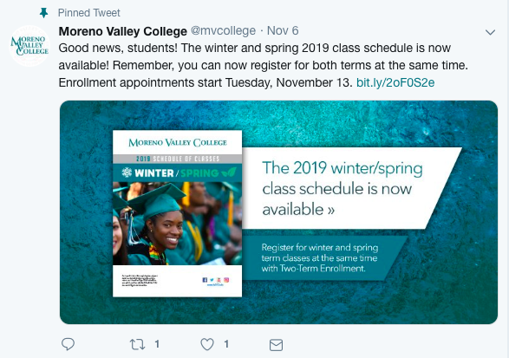
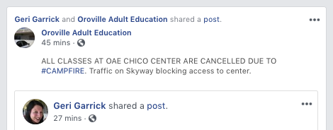
One-way announcement
Notes:
Example: class schedule now available & provide direct link.
Similar to emails or direct mail.
No response expected.

Slide 17
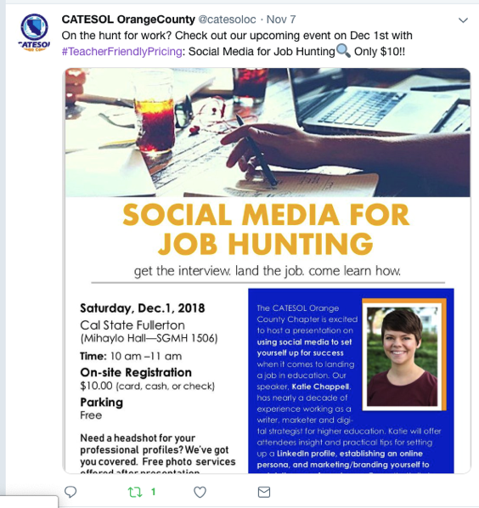
Professional development
Notes:
Share information/articles/videos about teaching and learning, conferences, webinars, job opportunities, etc.
Pose questions for colleagues to ponder and answer

Slide 18
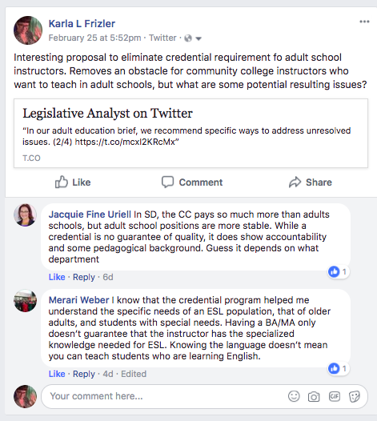
Discussion thread
Notes:
Examples: What classes would you like to see offered by [school]? What is one new idea you learned from today’s guest speaker [in class]?
This is what makes social media truly unique—it’s the two-way conversation
Users react to each other, engage in conversation

Slide 19
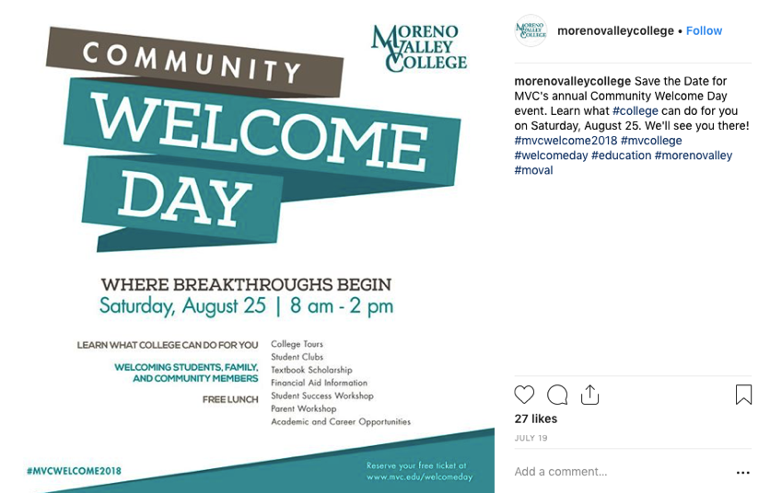
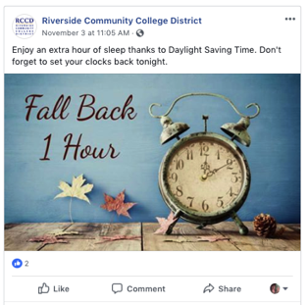
Calendar event
Notes:
Examples: Test dates; all-campus events (e.g. clubs); fundraisers
creates a reminder
can export item and add to calendar
Indicate interest (which shows to those connected to you)
easy to share with others
can participate in discussions about event
What are the benefits of sending out this information through social media rather than email? Should you send both?

Slide 20
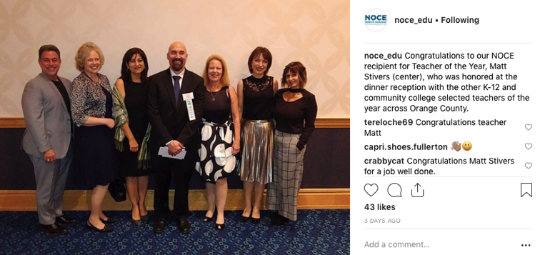
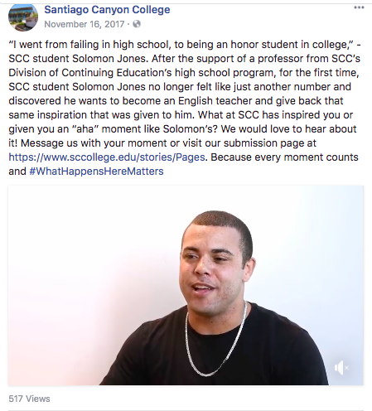
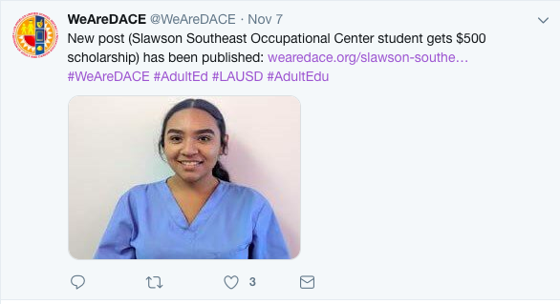
Success Stories
Notes:
Examples: Student graduates/diploma recipients; scholarship recipients; teacher of the year (or award recipient)
Important to get subject’s permission
Can highlight student achievement, faculty awards and honors, agency kudos (e.g. Best Place to Work …)
https://www.sccollege.edu/stories/Pages

Slide 21
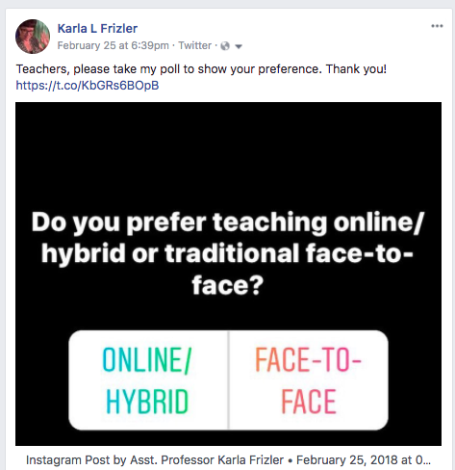
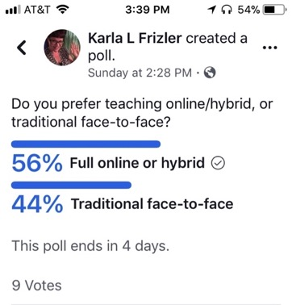
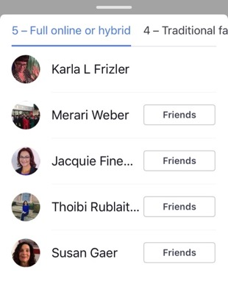
Poll
Notes:
Examples: Which of the following career paths – or certificate programs - are you most interested in?
Instantaneous results – get quick feedback from users
Instagram polls disappear after 24 hours in story
Facebook polls permanent (but may not show in feed after initial responses)

Slide 22
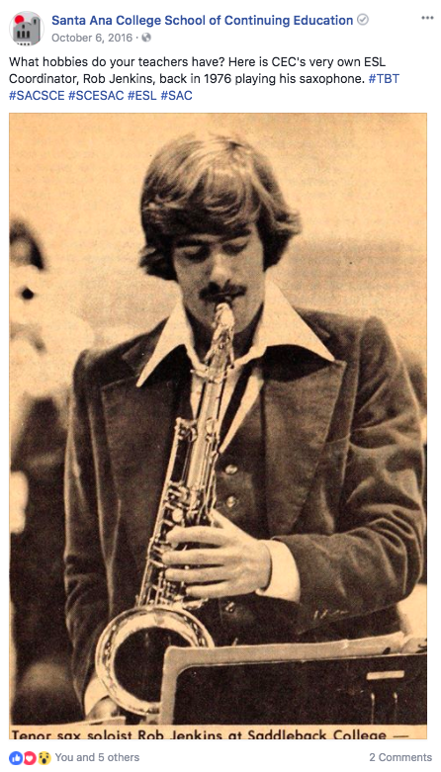
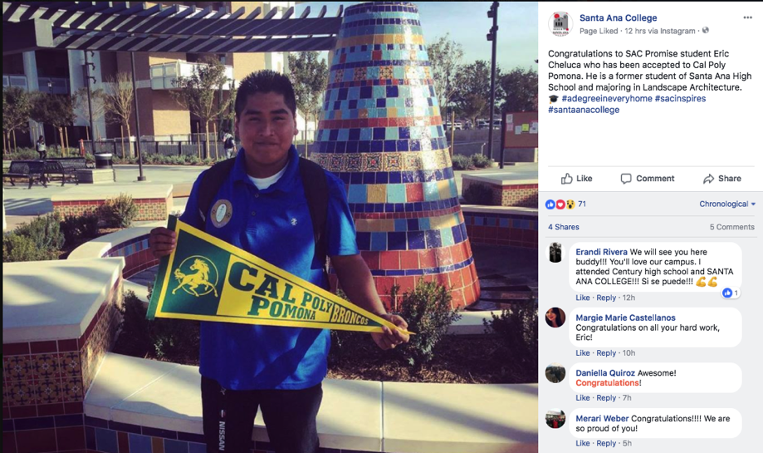
Photo
Notes:
Can engage in discussion or just serve as announcements
Inspirational messages (filler)
Throwback Thursdays on FB – photo from past @ school to spark conversation?
Photos around campus; classroom activity (see it, don’t just read about)

Slide 23
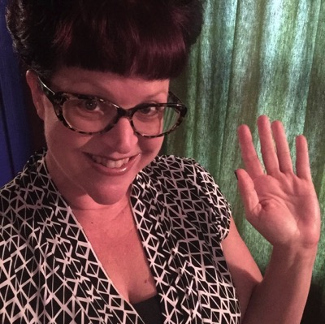
Questions? Comments? Ideas?
Karla Frizler Subject Matter Expert, OTAN
To arrange F2F training for your agency, administrator request to OTAN: support@otan.us To contact me directly:
karlafrizler.com • frizteach.weebly.com
kfriz@me.com • 657-229-5252
Notes:
If you would like a more in-depth workshop tailored to your agency or region, have an administrator contact OTAN directly with a request. (Must be WIOA-funded)

Slide 24
PART II: DEVELOP A SOCIAL MEDIA MARKETING PLAN
Notes:
Check Facebook, LinkedIn, Twitter for earlier group post – accept new “friends” in FB

Slide 25
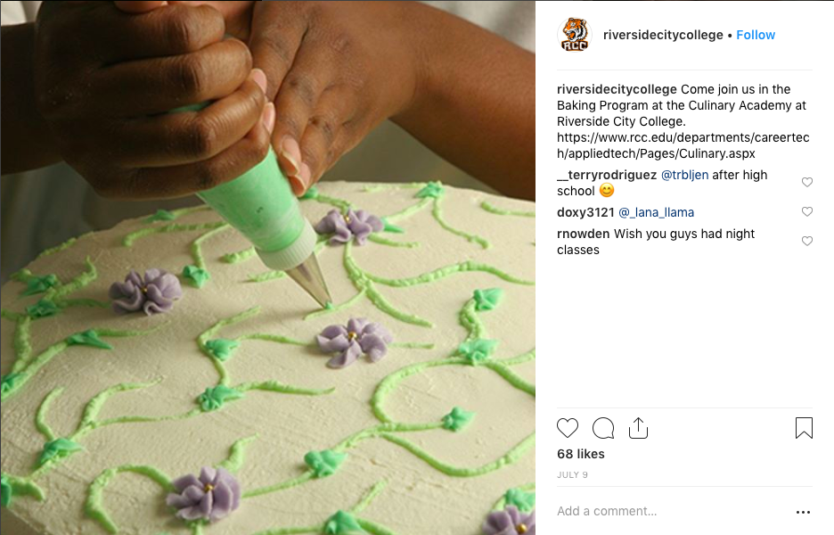
Evaluate a Social Media Posting
Overall, what works well and what needs improvement?
Purpose
Audience
Effective message
Call to action
Hashtags
Notes:
[5 min]
What is the purpose?
Who is the audience?
Is the message effective? Why or why not?
Is there a call to action? If so, what is it? If not, should there be? What should it be?
Are hashtags used effectively? Would you add any?

Slide 26
ACTIVITY!
Photo by Saulo Mohana on Unsplash
Notes:
Handout – p. 1: Evaluate social media postings. Would you edit/change anything?

Slide 27
Overview: Roles
Existing Outreach/Marketing Staff
Social Media Manager or Coordinator
Content Manager
Graphic Designer (infographics)
Photographer
Analytics
Student Interns
Notes:
[5 min] – Existing Outreach/Marketing staff can build skills through your Adult Education classes. Suggestion: create a section for staff and give them release time for professional development

Slide 28
ACTIVITY!
Photo by Saulo Mohana on Unsplash
Brainstorm: Social Media Marketing Plan for your agency or department
Notes:
Handout – p. 2: Work with team or partner to brainstorm social media for your agency.

Slide 29
Caveats/Things to Consider
“Buy in” – faculty, students, staff, management
Privacy concerns
Create generic agency/department accounts
Personal/professional accounts
Training needs – faculty, staff, management
Workload
Committee to create and facilitate plan
Consistency and variety (metaphor)
ROI
Free vs. paid options (boosts)
Notes:
[10 min]
Report back and fill in where necessary

Slide 30
Questions? Comments? Ideas?
Karla Frizler Subject Matter Expert, OTAN
To arrange F2F training for your agency, administrator request to OTAN: support@otan.us To contact me directly:
karlafrizler.com • frizteach.weebly.com
kfriz@me.com • 657-229-5252
Notes:
If you would like a more in-depth workshop tailored to your agency or region, have an administrator contact OTAN directly with a request. (Must be WIOA-funded)

Slide 31
About OTAN
Vision: To lead California adult education in the integration of technology into the educational process, ultimately empowering learners to meet their academic, employment and civic goals. [short video]
Training: f2f & online
Digests: for teachers & for administrators
News
Teaching with Technology
Technology and Distance Learning Symposium

Slide 32
Thank you! Enjoy the rest of the conference!

