Slide 1
Smile! This session is being recorded.

Slide 2




OTAN Tech Talk 1:
Social Media Safety Tips
Karla Frizler, OTAN Technology Integration Expert
Webinar 4/20/2018

Slide 3
AGENDA
Overview: This OTAN Tech Talk features tips for staying safe while you build a social media presence on Facebook, Instagram, Twitter, and Snapchat.
Topics:
Setting up
Connecting
Sharing
Managing settings

Slide 4
SETTING UP

Slide 5
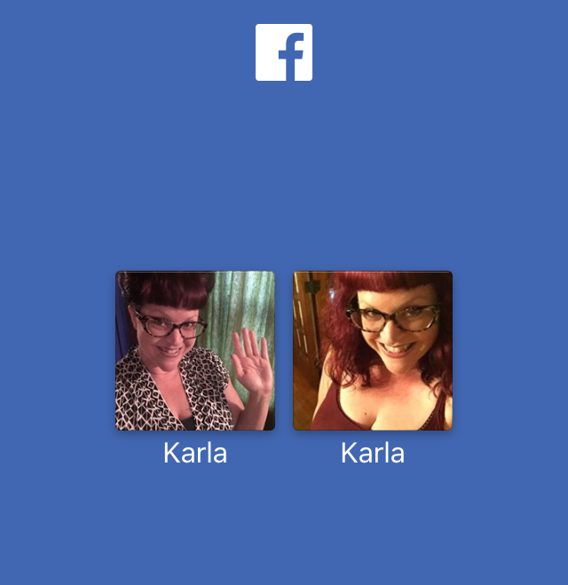
SETTING UP
Professional &
personal accounts
Strong passwords
  Upper & lowercase letters
  Number
  Symbol
  Don’t use “password” or “12345”

Slide 6
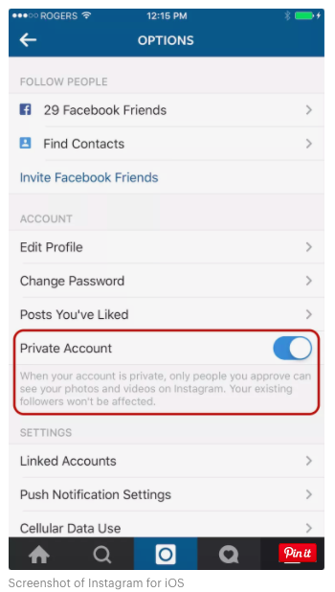
SETTING UP
Public vs. private account (IG)
  Change in phone app
  Settings/Options → Private Account

Slide 7
CONNECTING

Slide 8
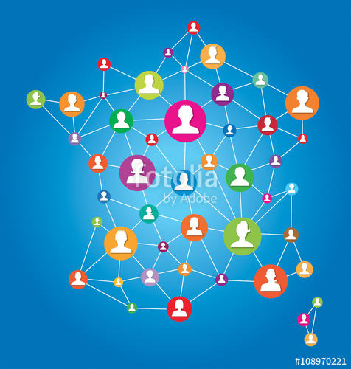
CONNECTING
Individuals
Groups
Organizations
Businesses

Slide 9
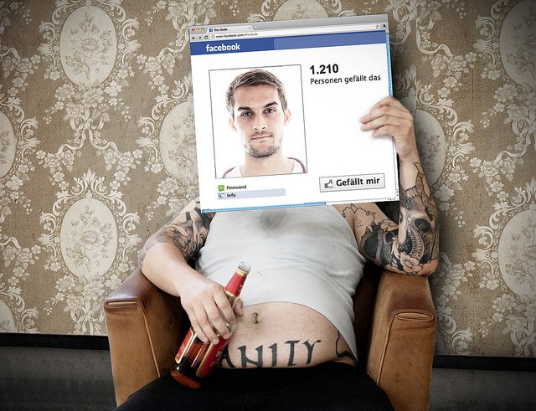
CONNECTING
Catfishing
Only connect with people you know!
technobuffalo.com

Slide 10
SHARING

Slide 11
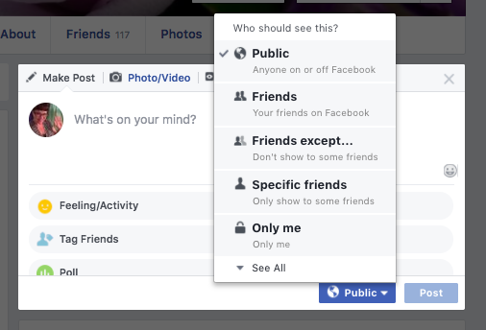
SHARING
Don’t post anything online you wouldn’t say or do in public
Customize audience of posts

Slide 12
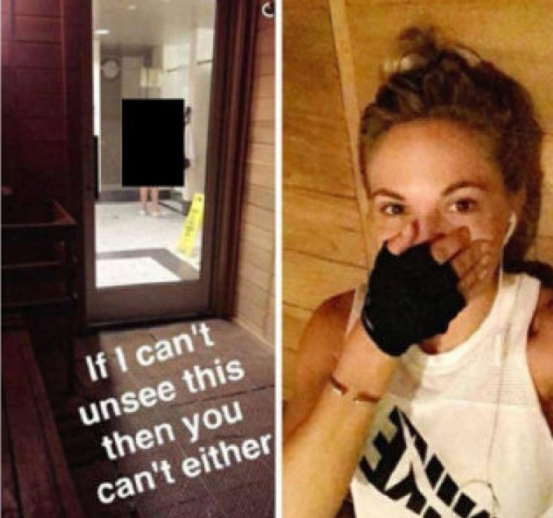
SHARING
Send direct messages
Respect the privacy of others

Slide 13

SHARING
Avoid oversharing:
  “checking in” at public locations
  announcing you’re on vacation
  playing games & quizzes
  Posting personal information (phone, address, relationship status, children’s school)

Slide 14
MANAGING SETTINGS

Slide 15

MANAGING SETTINGS
Look for cog wheel
Default settings open
Revenue generated by ad sales
  Settings allow tracking

Slide 16
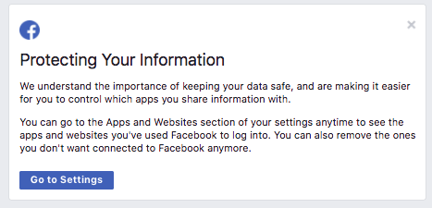
MANAGING SETTINGS

Slide 17
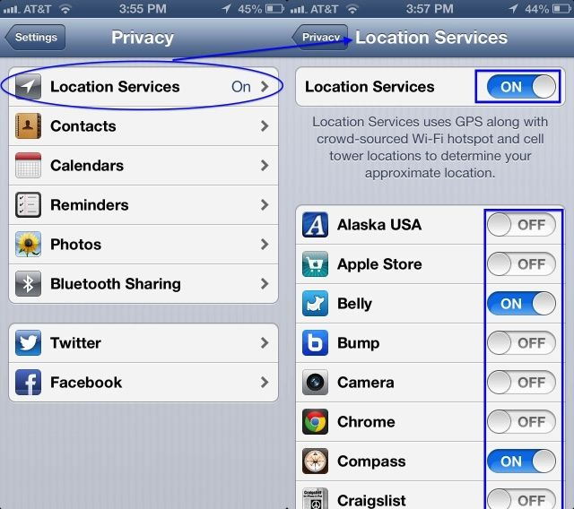
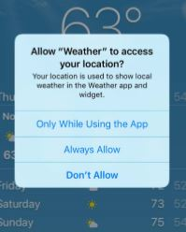
MANAGING SETTINGS
Location Services
  Change from “Always” to
  “While using the app”

Slide 18
SUMMARY

Slide 19
SOCIAL MEDIA RECOMMENDATIONS
Customize your privacy settings
Use strong passwords
Only connect with people you know
Avoid games and quizzes
Keep personal information offline
Tag photos and check-in to locations only with others’ permission
Log out of sites/apps when done

Slide 20

QUESTIONS? COMMENTS? NEED MORE?
Stay here for Q&A!
Karla Frizler,
OTAN Technology Integration Expert
frizteach.weebly.com
To arrange training for your agency, make a request through OTAN

Slide 21

Thank you!

