Slide 1
Smile! This session is being recorded.

Slide 2

OTAN Tech Talk:
LinkedIn for Adult Educators
Karla Frizler, Subject Matter Expert for OTAN
Webinar 7/13/2018

Slide 3
AGENDA
Overview: This OTAN Tech Talk features tips for adult educators to maximize use of LinkedIn to showcase professional expertise. Explore strategies for personal branding, job posting/searches, self publishing, and networking with local and global colleagues.
Topics:
Creating an account and setting up your profile
Connecting with, recommending, and endorsing colleagues
Posting and searching for jobs
Publishing content (such as articles) on topics of interest in your field

Slide 4
What is LinkedIn?
Online network of professionals
Search engine powered by keywords

Slide 5
Why Use LinkedIn?
Showcase professional expertise
Provide links to examples of work
Exchange recommendations & endorsements with others
Follow up after conferences or professional development
Search for job openings
Post jobs and evaluate potential candidates
Research companies or agencies with which you may be collaborating
Publish on topics of interest in your field of expertise
Stay connected with former colleagues and students

Slide 6
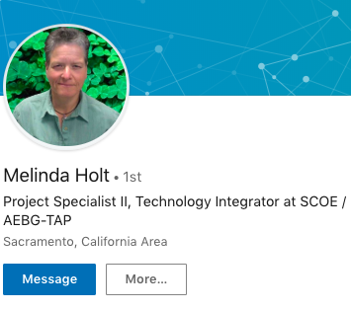
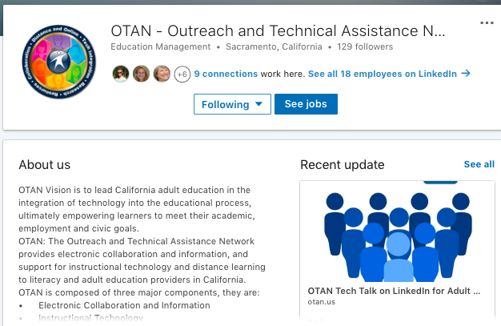
Getting Started
Individual account
Company page
  Agencies
  Institutions
  Companies
  Consultants
  (e.g. tutoring)

Slide 7
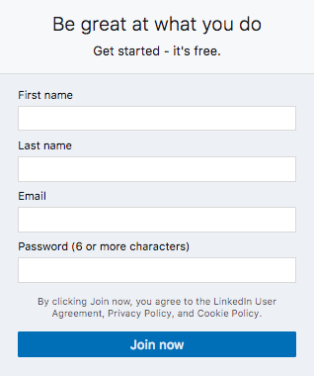
Creating an Account
Sign up for a LinkedIn account
  Enter your zip code, and most-recent job title and employer name
  Connect to colleagues, friends, and family
  Upload a photo
  OK to “Skip” and return later

Slide 8
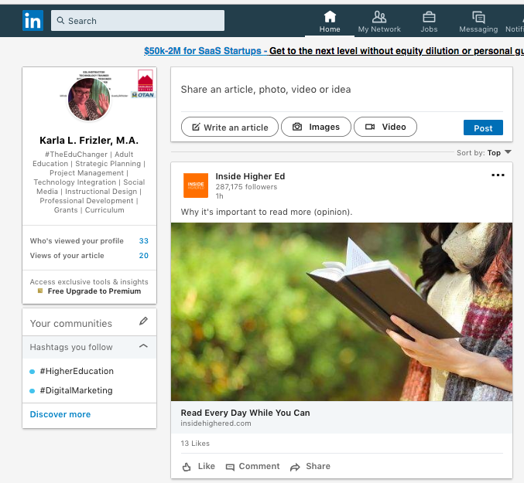
Setting Up a Profile

Slide 9
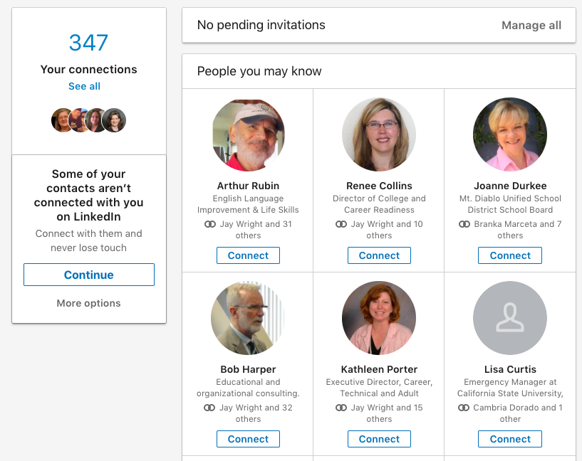
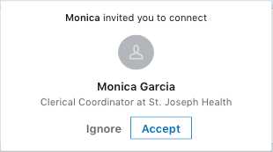
Connecting With Colleagues
“My Network”
Manage/pending invitations
“People you may know”
“Your connections” – see all

Slide 10
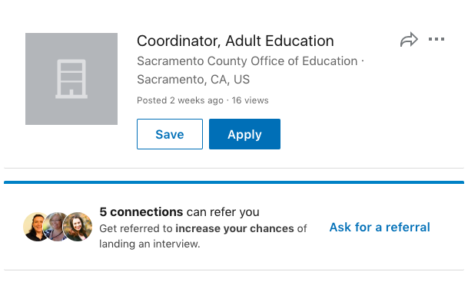
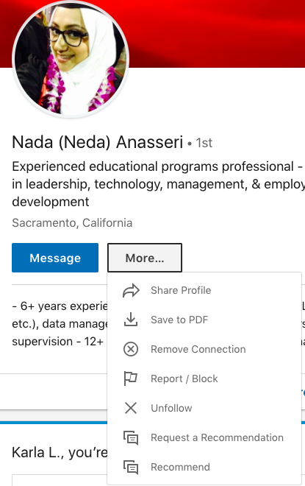
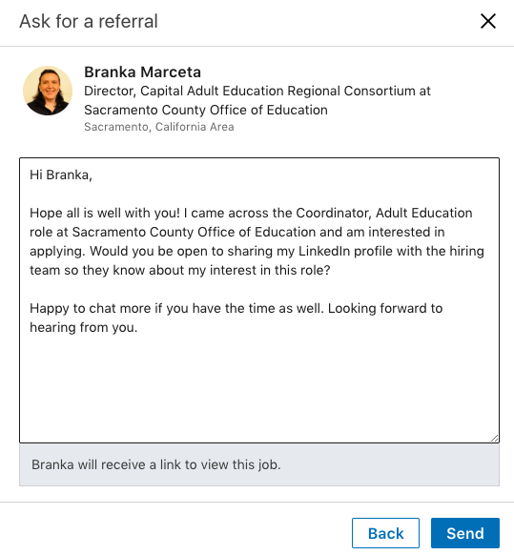
Referrals and Recommendations

Slide 11
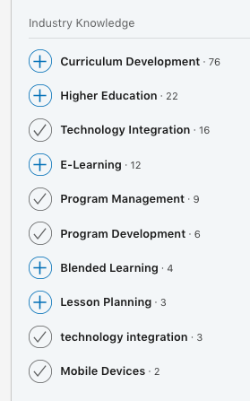
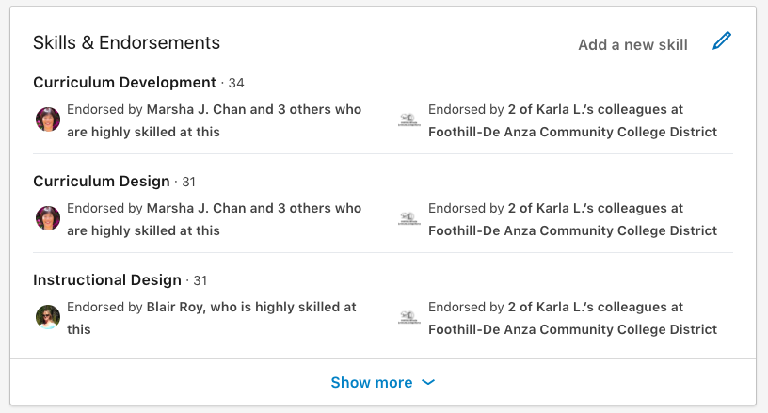
Skills & Endorsements

Slide 12
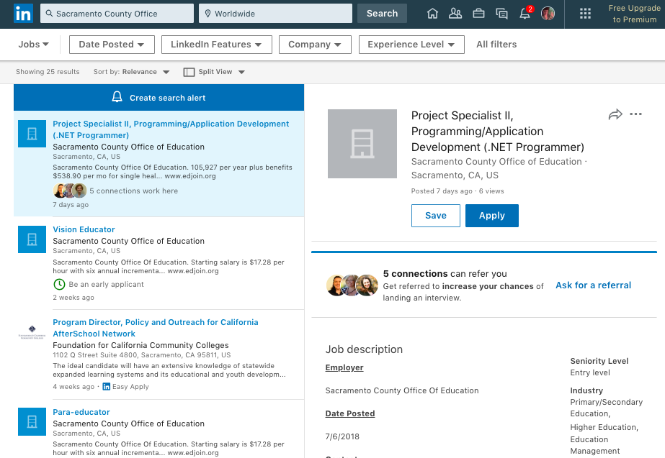
Searching for Jobs
Notes:
Search for specific employers, job titles, locations, and other parameters you set. Results will appear in a list and you can explore the company, save a job posting, apply directly, ask for referrals from connections, and view the full job description here.

Slide 13
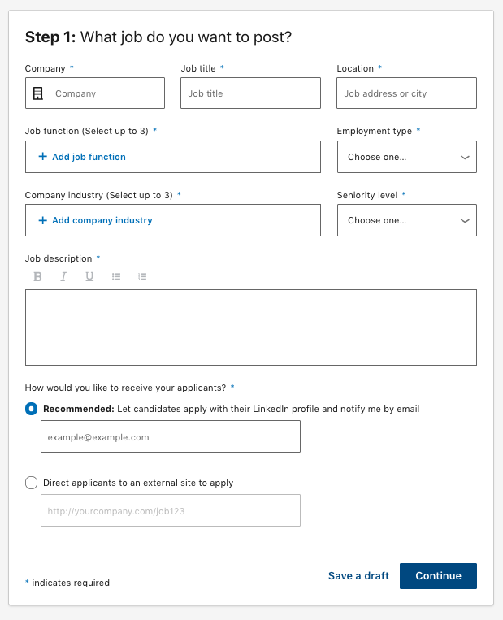
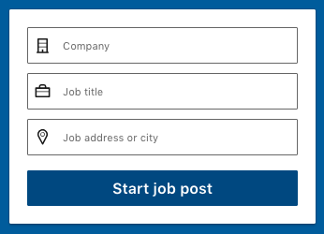
Posting Jobs

Slide 14
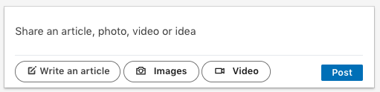
Publishing Content
Direct post
Article
  Q&A; Case study
Images
Video
Topics of interest
Promote your ideas and solutions to problems in your field(s) of expertise
Notes:
This is the feature many educators will be excited about. From your homepage, in the middle column, you can select multiple ways to share your original content on LinkedIn. The simplest is to submit a direct post. Just type your thoughts in the text box and click “Post.” You may also want to publish articles, Q&A, or case studies. They would all fall under “Write an article.” In addition, you can post images and video clips that you create, such as a short screencast or an infographic.
What should you write about? Do you have an area of expertise? Do colleagues ask for your advice or perspective about particular topics? Identify problems, issues, or concerns in the field, and address them in your articles. Think about topics that come up frequently in your faculty and management meetings. You can always post a prompt on social media to generate writing ideas, such as, “What is a common misconception about the teaching profession?” or “How do you motivate introverted students to participate in class discussions?” Trust me, the responses you get to questions like that will give you lots of ideas for articles.
So, let’s say we’ve selected the button to “Write an article,” and let’s see what that looks like …

Slide 15
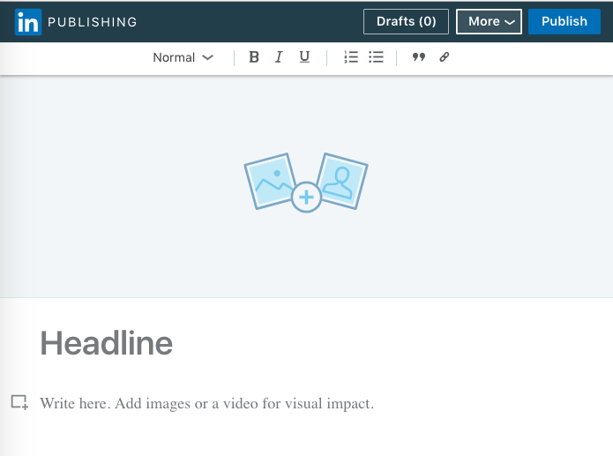
Write an Article
Basic word processor
Minimal formatting features
YOU are the editor!

Slide 16
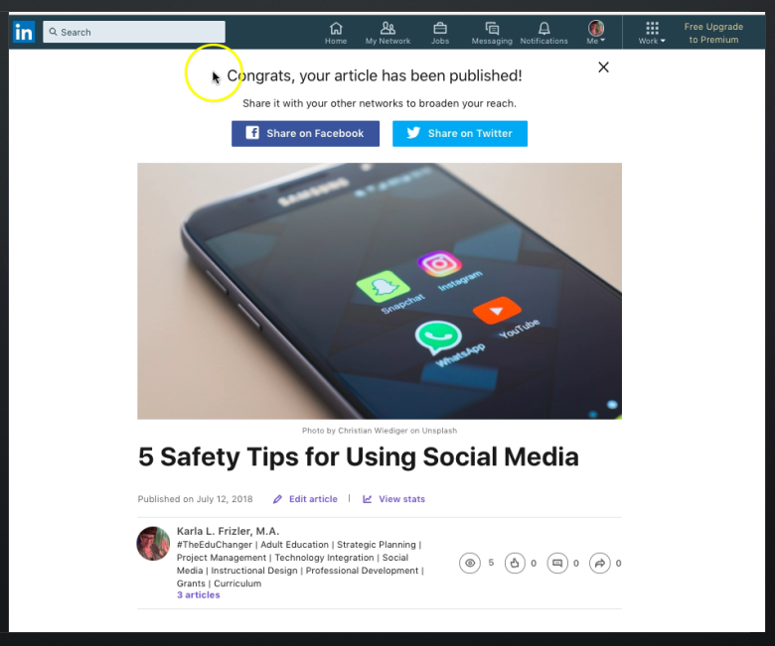

Slide 17
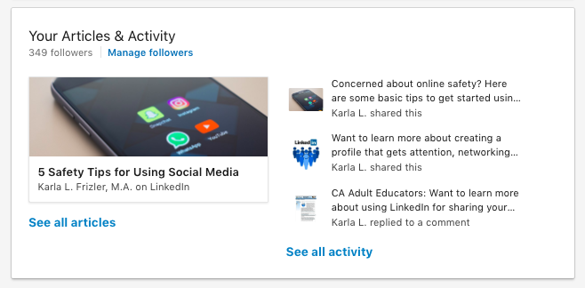
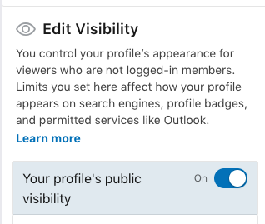
Publish an Article
Automatically connects to profile

Slide 18
Summary: LinkedIn for Adult Ed
Keep posts and interactions professional
Connect with everyone!
Ask for and give recommendations and endorsements
Utilize the publishing feature to share original content

Slide 19
Host Your Own Tech Talk
Have information or experience people ask you to share?
Is there a topic or resource you’d like to learn more about?
Sign up to host a Tech Talk for OTAN and it will give you the impetus to get started!

Slide 20

Questions? Comments? Need more??
Stay online for Q&A!
Karla Frizler, OTAN Subject Matter Expert
frizteach.weebly.com, kfriz@me.com
To arrange training for your WIOA-funded agency, please contact OTAN directly
Many thanks to #DeepGenius Nancy Marmolejo for introducing me to the advanced features of LinkedIn.

Slide 21

Thank you!

