Slide 1
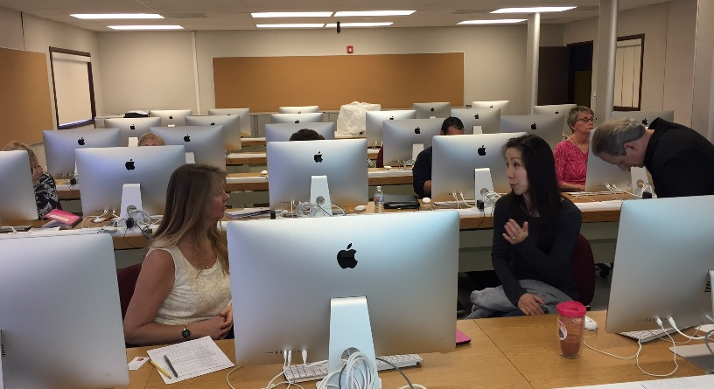
Faculty Communication & Collaboration Online
Presented by Karla Frizler, Adult ESL Program Coordination, Saddleback College TDLS, Fresno • March 11, 2016
Notes:
In preparing this presentation, I realized I don’t have many photos of my faculty!

Slide 2
Today’s Agenda
Identify adjunct faculty needs for communication and collaboration
Discuss effective strategies for supporting faculty at multiple sites
Exchange tips on using technology to enhance communication
Share resources/tools available

Slide 3
Interact Today!
Take this poll to begin: http://www.pollev.com/karlafrizler485
Post questions here (even if off-topic) : https://todaysmeet.com/FrizPrez
Notes:
Return at end of session to make sure all questions answered

Slide 4
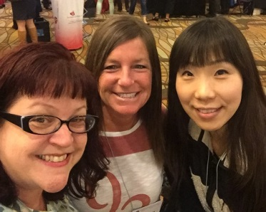
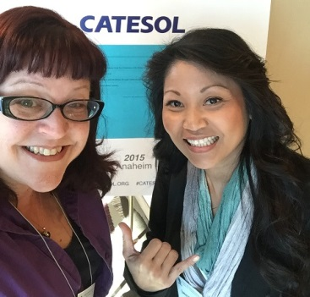
Needs & Challenges
Need: Consistent information out to all faculty
Challenge #1: Adjunct faculty @ multiple sites
Challenge #2: AB86 transition K-12 to community college
Fear of unknown
Misinformation/inconsistent information
Need: Document and share policies, procedures & forms via central website
Challenge #1: Technical tools
Challenge #2: Maintenance/upkeep
Need: Collect faculty input on instructional issues & student services
Need: Ongoing professional development
Challenge: adjunct faculty working multiple jobs, with minimal availability for PD
Notes:
Background: I was hired by Saddleback College in July 2015 to facilitate the transition of Adult ESL classes from the local K-12 districts to the community college in the South Orange County Regional Consortium. Thrown into a “busy” situation. Organized chaos! The program did not exist before I arrived. Curriculum had just been approved! Hiring was still in process into first week of term.
Analogy: Taking people from a small town and throwing them into the big city. Some will enjoy that process and thrive, but most need a “tour guide.” I’m the tour guide for our faculty.
How many in room from Adult Ed? Community College? Both?
My background is in both community college and Adult Education.

Slide 5
Strategies for Faculty Support
Web-based “clearinghouse” for all docs
Email updates w/attachments
Invitations to add calendar events
Polls – collect input
Quizzes – comprehension check
Model for faculty what they can do with their students
Notes:
No matter how much information I send electronically, I still meet with faculty in person at least once each month – professional development and “office hours”

Slide 6
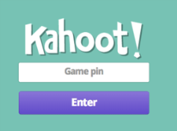
Tools & Resources Available
Weekly email update via Outlook
Meeting/training invitations via Outlook
Agenda in notes section
Reminder few days before session
Blackboard Site for AESL Program (example)
Limitations: available only to active instructional faculty; no staff/sub access
Google Drive
Poll Everywhere (example)
Kahoot! [play]
Notes:
College in process of deciding whether or not to adopt Canvas as LMS (instead of Blackboard)

Slide 7
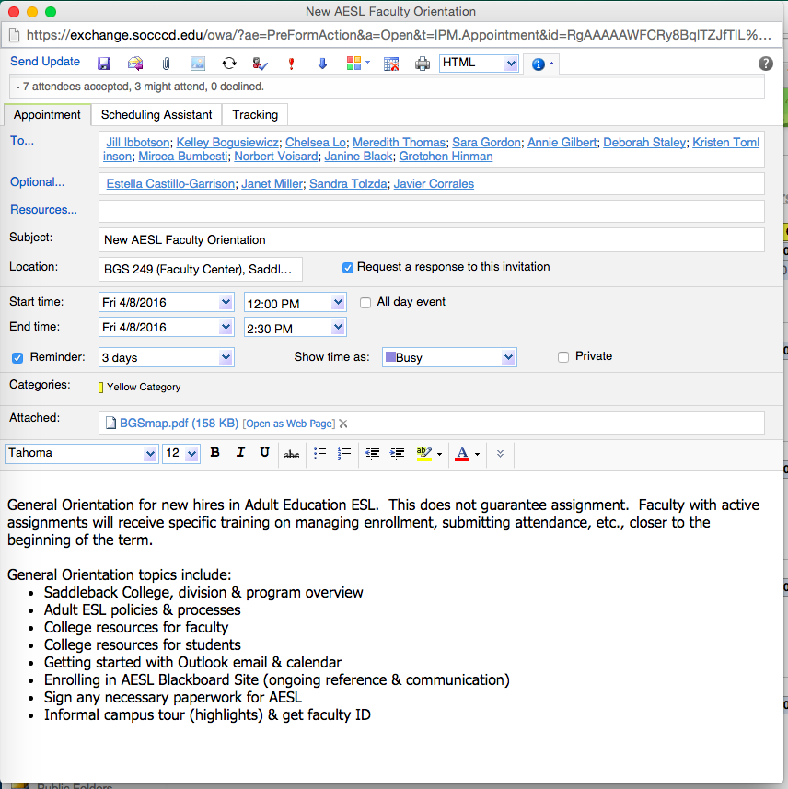

Slide 8
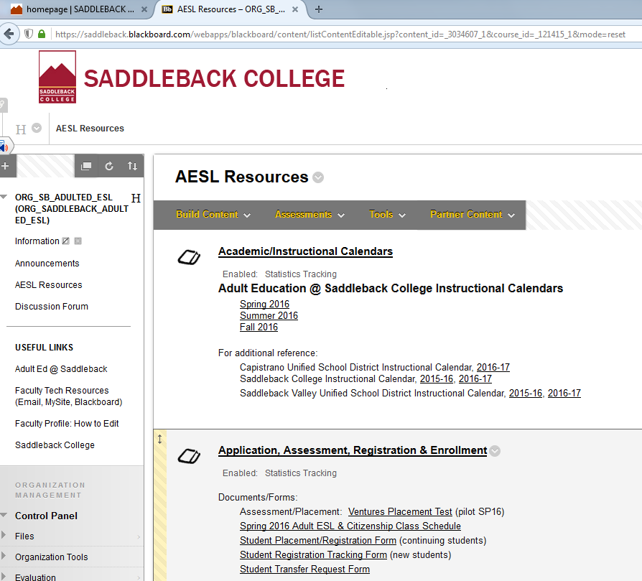

Slide 10
Other Ideas?
Please share how you keep faculty connected at your agency or institution
http://www.padlet.com/kfrizler1/TDLS http://www.todaysmeet.com/FrizPrez
Notes:
Share with group & discuss – also, return to Today’s Meet and see if all questions answered.

Slide 11
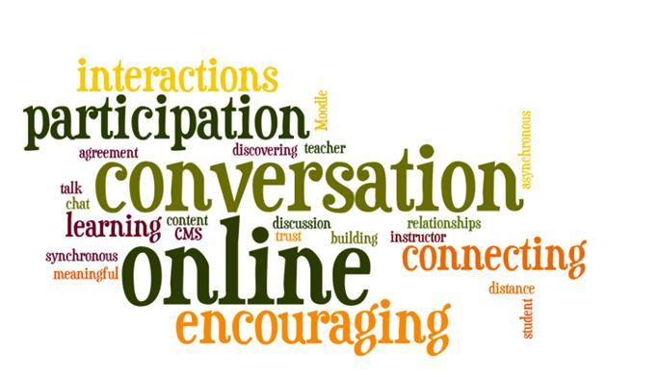
Want to Connect?
Questions? Karla Frizler, Adult ESL Program Coordination Saddleback College, kfrizler@saddleback.edu, 949-348-6867 Faculty Profile: http://www.saddleback.edu/kfrizler
Conference materials: frizteach.weebly.com
Notes:
You can find a zip file with all presentations, handouts, etc. for this topic available from my Saddleback faculty profile, or directly at my Weebly site.
Find me on LinkedIn!

